Slide 1
Department of Surgery University of Florida
Division of Vascular Surgery and Endovascular Therapy

Slide 2
Division - Mission
The Division of Vascular Surgery at the University of Florida is committed to providing the highest quality of cutting edge vascular surgical care, while training the next generation of premier vascular surgeons, and engaging in research that will allow better understanding and treatment of vascular diseases in the future.
http://vascular.surgery.med.ufl.edu/education/

Slide 3
Standards of Excellence
Clinical Care
Research
Education

Slide 4
Faculty
Clinical – UF COM Gainesville
Thomas S. Huber, MD, PhD, Professor and Chief
Gilbert R. Upchurch, Jr., MD, Professor and Chair
Scott A. Berceli, MD, PhD, Professor and Chief (VA)
Martin R. Back, MD, MS, Professor
Salvatore T. Scali, MD, Associate Professor
Javairiah Fatima, MD, Assistant Professor
Kristina A. Giles, MD, Assistant Professor
Dean Arnaoutakis, MD, MPH, Assistant Professor
Michol Cooper, MD, PhD, Assistant Professor

Slide 5
Faculty
Research – UF COM
Kerri O’Malley, PhD, Assistant Professor
Zhihua Jiang, PhD, Assistant Professor
Yong He, PhD, Assistant Professor
Clinical – UF COM - Halifax
Robert J. Feezor, MD, Associate Professor
Michael Yacoub, MD, Assistant Professor

Slide 6
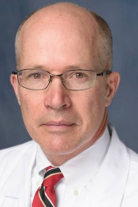
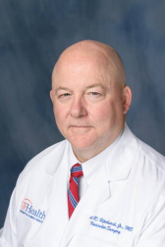
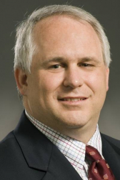
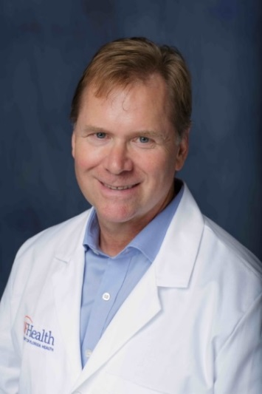
Clinical Faculty – COM Gainesville
Thomas S. Huber, MD, PhD
Professor and Chief
GS – Michigan
VS - Michigan
Gilbert R. Upchurch, Jr, MD
Professor and Chair of Surgery
GS - Brigham and Women’s
VS - Brigham and Women’s
Scott A. Berceli, MD, PhD
Professor and Chief VAMC
GS – New England Deaconess
VS - Washington
Martin R. Back, MD, MS
Professor
GS – UCLA
VS - Florida

Slide 7
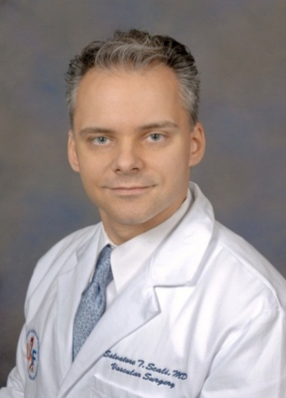
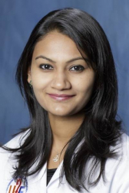
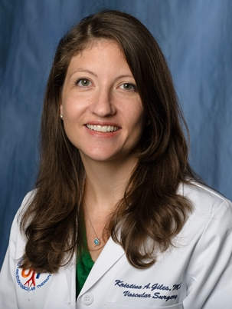
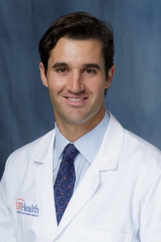
Clinical Faculty – UF COM Gainesville
Salvatore T. Scali, MD
Associate Professor
GS – NE Deaconess
VS - Dartmouth
Javairiah Fatima, MD
Assistant Professor
GS – Mayo
VS – Cleveland Clinic
Kristina A. Giles, MD
Assistant Professor
GS – NE Deaconess
VS - Dartmouth
Dean J. Arnaoutakis, MD, MBA
Assistant Professor
GS – Johns Hopkins
VS – Brigham and Women’s

Slide 8
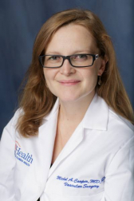
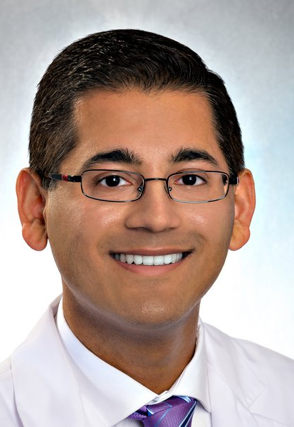
Clinical Faculty – COM Gainesville
Michol Cooper, MD, PhD
Assistant Professor of Surgery
GS – Johns Hopkins
VS – Massachusetts General Hospital
Samir Shah, MD, MPH
*Starting 10/1/2019
Assistant Professor of Surgery
GS- Cleveland Clinic
VS- Brigham and Women’s

Slide 9
Vascular Fellowship
Our mission is to produce a modern vascular surgeon with the necessary technical skills in open vascular surgery and endovascular therapies in order to independently handle the entire gamut of vascular pathologies.
These technical skills are backed by a broad knowledge base of the fundamentals of vascular literature through a structured program of didactic and interactive case conferences.
The Fellowship program has been designed to accommodate applicants with future interests in either academic vascular surgery or private practice and past graduates have been successful in both arenas

Slide 10
Vascular Fellows
Current
Jeff Crawford, MD – Oregon
Karen Parks Rudolph, MD– Louisville
Zain Shahid, MD – UT-Southwestern
Kenneth Desart, MD – Florida
Incoming
Derek Klarin, MD – MGH
Jon Rehfuss, MD - Florida

Slide 11
Standards of Excellence
Clinical Care
Research
Education

Slide 12
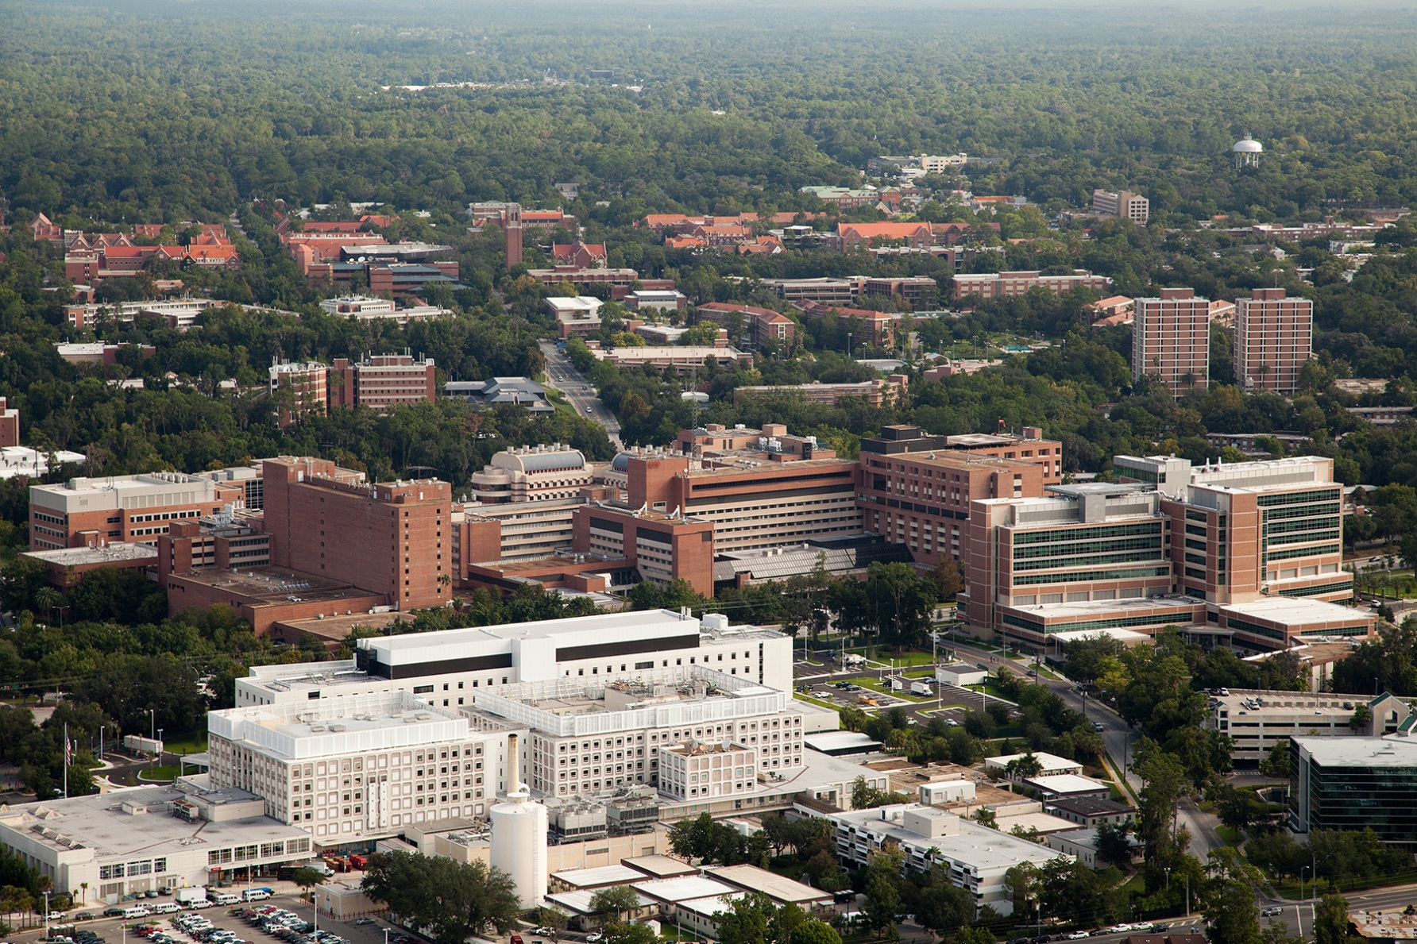

Slide 13
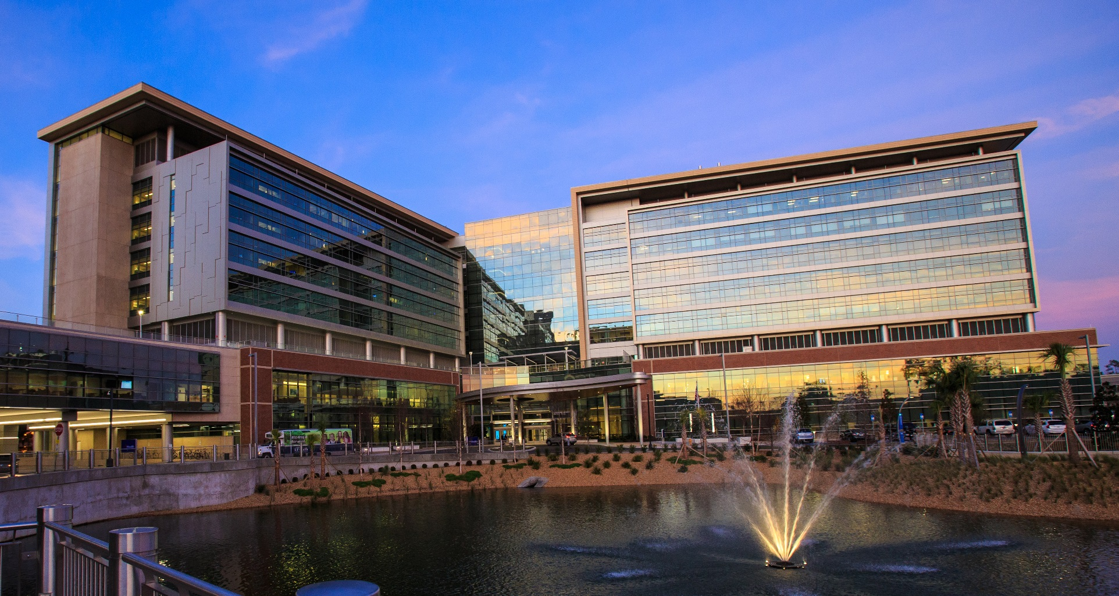
Heart and Vascular Hospital – 12/17

Slide 14
Fellowship Rotations
Open Vascular (Shands) | Runs clinical service Majority of “open” cases Clinic on Friday
Endovascular (Shands) | Assists with clinical service Majority of “endo” cases Clinic on Tuesday
“Hybrid fellow” (Shands) | Assists with clinical service Clinic on Wednesday
VAMC | Endovascular cases at the VAMC Vascular Ultrasound Resource for PGY-4

Slide 15
Fellows’ Weekly Schedule
 | Monday | Tuesday | Wednesday | Thursday | Friday
UF Open | OR 5 | OR 5 | OR 5 | OR 5 | Clinic
UF Endo | OR 9 | Clinic | OR 9 | OR 9 | OR 5/9
UF Hybrid | OR 10 | OR 9/10 | OR 10 | OR 10 | OR 10
VAMC | VAMC | VAMC | VAMC | VAMC | Clinic
Room 05 – traditional operating room
Room 9 – hybrid suite
Room 10 – hybrid suite

Slide 16
“Open” Fellow
Primary management of the Shands/UF inpatient service (endovascular + open).
Emphasis on open cases performed at Shands/UF.
Call – q5 (ENDO/VAMC/HYBRID/Resident).
UF Health Vascular Clinic (Friday).

Slide 17
“Endovascular” Fellow
Focus on endovascular cases at Shands/UF.
Call – q5 (OPEN/VAMC/Resident).
UF Health Vascular Clinic (Tuesday).

Slide 18
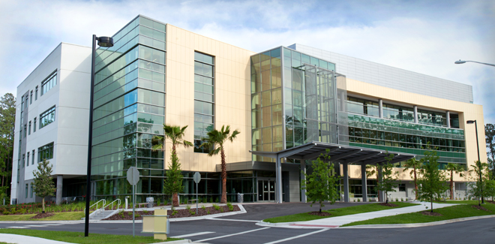
“Hybrid” Fellow
Focus on open and endovascular cases at Shands/UF.
Call q5 (OPEN/ENDO/HYBRID/Resident).
UF Health Vascular Clinic (Wed)
UF Health Comprehensive Vein Center (TBD)

Slide 19
VAMC Fellow
All endovascular cases at VAMC.
Vascular laboratory/advanced imaging.
RPVI requirement.
VAMC vascular clinic (Fri).
Call q5 (OPEN/ENDO/HYBRID/Resident).
Backup 4th yr Resident at VAMC.

Slide 20
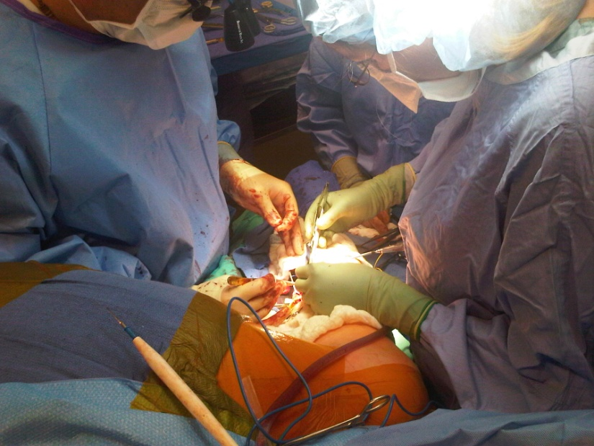
Shands/UFHealth Vascular Team
Attendings (Huber, Back, Fatima, Arnaoutakis, Upchurch, Cooper, Shah-Oct 1st).
Vascular Fellows/General Surgery Residents.
Nurse Practitioners/Physician Assistants.
Research Coordinators.
Vascular Technologists (8500 studies/year).
Discharge Coordinator/Social Worker.
Dedicated OR personnel.
Electronic medical record (EPIC).

Slide 21
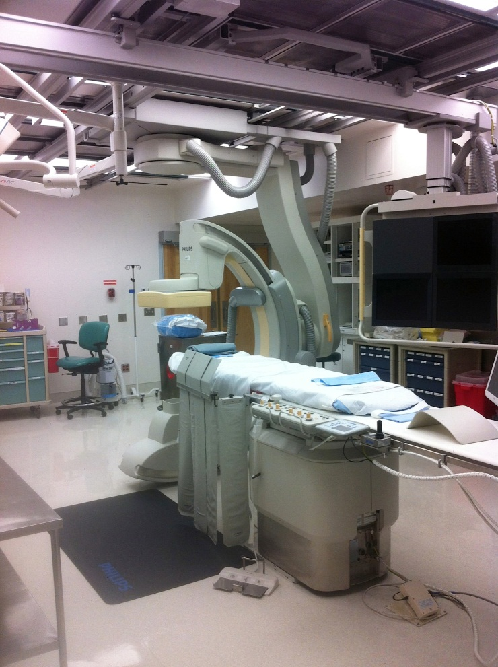
VAMC Vascular Team
Attendings (Berceli, Scali, Giles).
Vascular Fellow/General Surgery Residents.
Physician Assistant/Nurse Practitioner.
Nurse Research Coordinators.
Vascular Technologists (2500 case/year).
Electronic medical record (CPRS).
Dedicated endovascular suite.

Slide 22
Vascular Service – Residents ’18-19
Shands/UF Health
3 Vascular Fellows
1 PGY-3
2 PGY-1
Malcom Randall VAMC
1 Vascular Fellow
PGY-4 Chief Resident
PGY-1

Slide 23
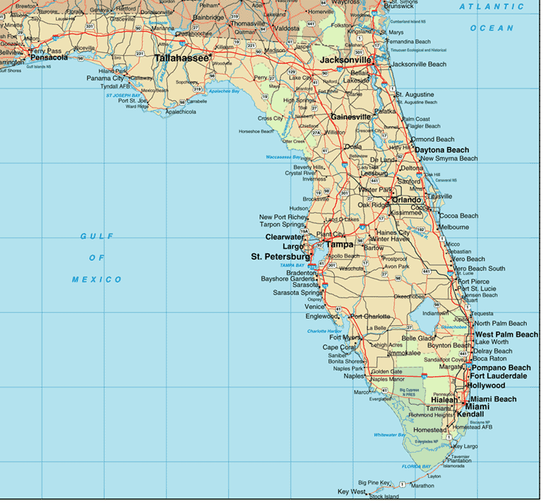
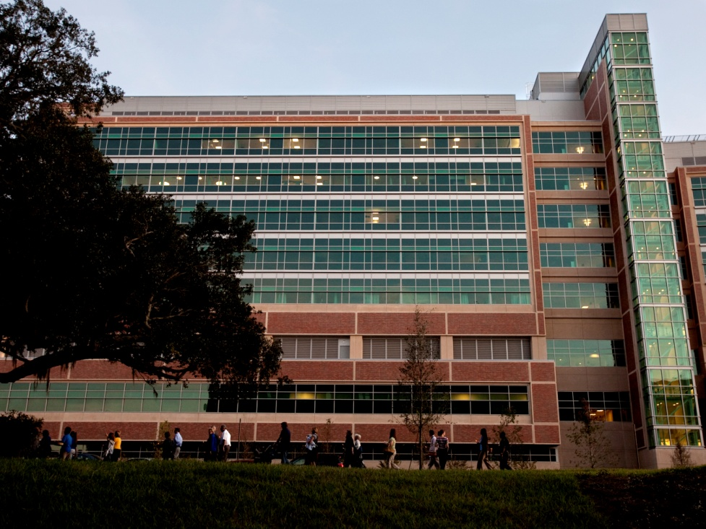
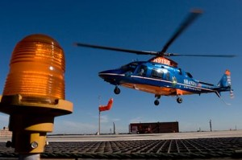
Shands/UFHealth
Clinical enterprise.
Teaching Hospital.
Tertiary care center.
Aortic Treatment Center.
Excellent referral base.
Level I Trauma.
Critical Care Service.

Slide 24
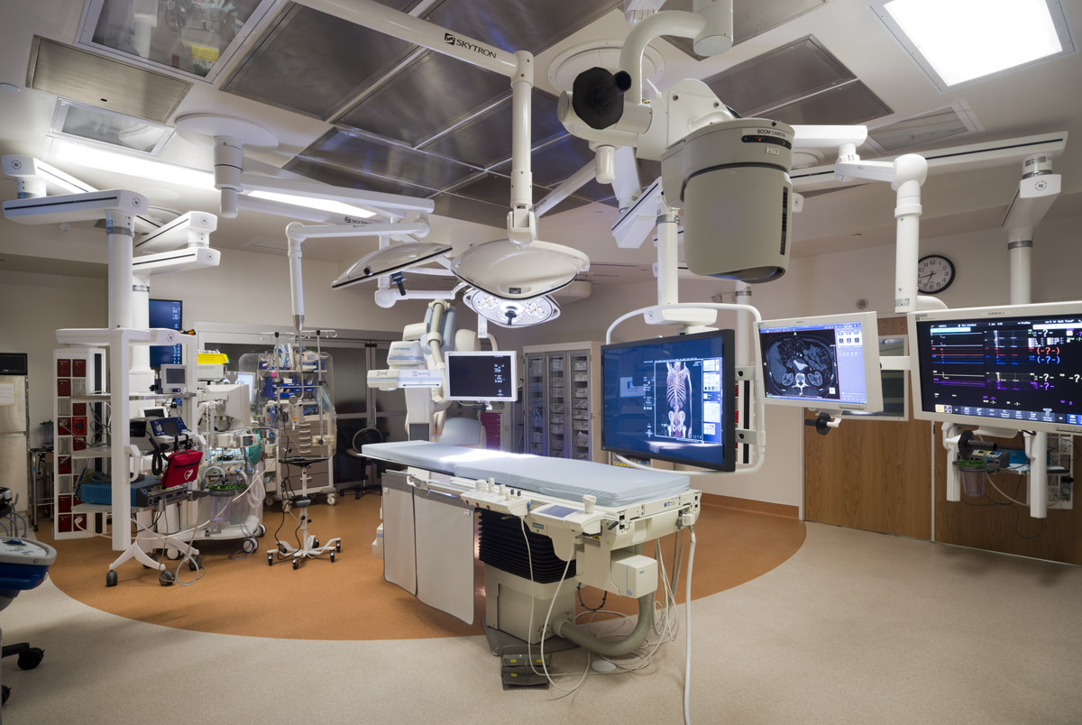

Slide 25
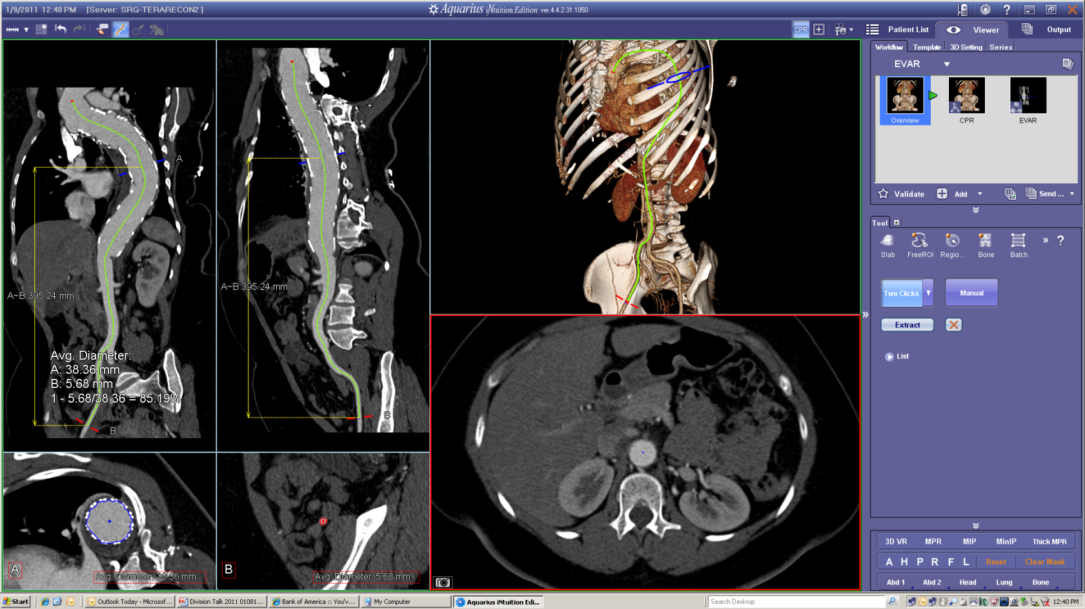
UF Health Imaging Laboratory
TeraRecon Aquarius workstations.
McKesson digital image workstation.

Slide 26
Case Volumes – UFHealth and VAMC

Slide 27
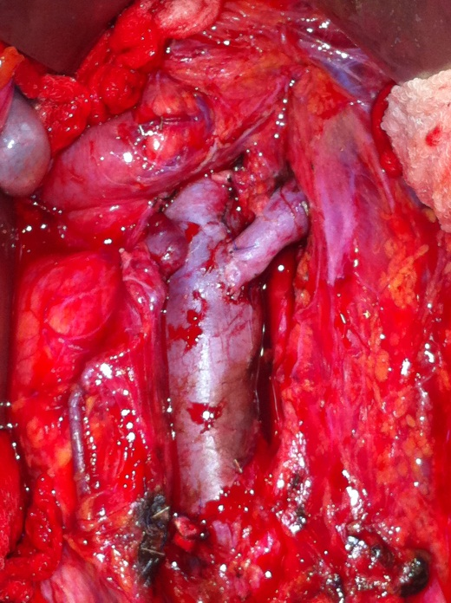
Open Vascular Procedures – UFHealth
Total cases– Shands (2017-2018)
165 Aortic
82 Carotid/cerebrovascular
217 Distal revascularization
76 Visceral revascularization
379 Dialysis
306 Amputations
157 Venous
214 Other
1596 CASES

Slide 28
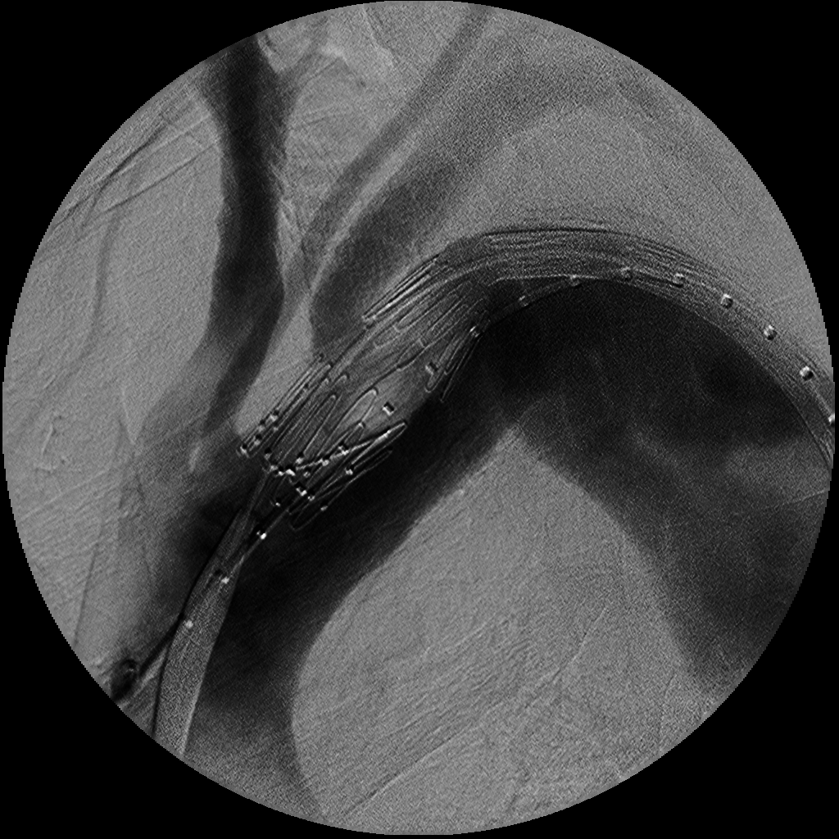
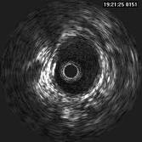
Endovascular Procedures
Shands/UFHealth (2017-2018)
179 Aortic
392 Peripheral
VAMC (2017-2018)
39 Aortic
135 Peripheral

Slide 29
Endovascular Procedures
Therapeutic Case Mix (PVOD)
Carotid stents
Arch vessel interventions
Renal/visceral interventions
Aorto-iliac interventions
Infrainguinal interventions
Dialysis-related interventions
IVC filters
Venous interventions (AVM, Complex Venous Occlusive)
Others

Slide 30
Aortic Volume at UFHealth

Slide 31
Fellow Case Volumes (Primary+Secondary)
Graduating Year | Index case number
2006 | 680
2007 | 780
2008 | 738
2009 | 845
2010 | 721
2011 | 841
2012 | 842
2013 | 846
2014 | 1047
2015 | 775
2016 | 902
2017 | 1027
2018 | 1071

Slide 32
VS ACGME Case Volumes 2017/2018
Category | National Average | UF Fellow (%)
Aneurysm | 87 | 196 (99)
Cerebrovascular | 67 | 61 (48)
Peripheral | 175 | 203 (72)
Mesenteric/renal | 15 | 34 (99)
Venous | 59 | 97 (83)
Endovascular diagnostic | 105 | 140 (82)
Vascular access (total) | 60 | 102 (84)
Total operations | 881 | 1071 (75)

Slide 33
Focus on Aortic Surgery
“…. Vascular fellows will complete 10 open aortic repair cases in 2015 and five in 2020 …”
National Avg. 2017-2018 ACGME Report
- Open Infrarenal AAA repair, Elective n = 8.9
- Open Infrarenal AAA repair, Rupture n = 2.6
- Aorto-iliac/femoral bypass, Obstructive, n = 7.8
- Open TAAA repair, n = 3.1
Graduating Year | %ile aortic aneurysm | %ile abdominal obstructive
2018 | 99 | 95
2017 | 98 | 92
2016 | 99 | 97
2015 | 99 | 90

Slide 34
Typical Week (2/19 – 2/24)
Sunday
TEVAR for aorto-bronchial fistula
Monday – 3 rooms
GSV ablation x3
Open Mesenteric bypass
SMA stent
Iliac stent
Antegrade TEVAR with TCV
IVC filter
BKA
TMA
TEVAR for BAI
I+D/washout leg hematoma
Leg wound washout
Tuesday – 3 rooms
Aorto-bi-femoral bypass
Brachial-basilic AVF
Open Juxtarenal AAA
Splenic artery embolization
TEVAR with Renal stent
TEVAR for BAI
Wednesday – 3 rooms
AV fistulogram with open revision
AV fistulogram
Exlap for Lymphatic Leak
Fem-tibial bypass with vein
RLE agram
L BKA
Ankle disarticulation
BKA debridement
Thursday – 3 rooms
AV fistulogram
2nd stage BVT
R iliac stent
Renal stent
AV graft (Brach-Ax loop)
AV fistulogram + open revision
Open AAA EVAR conversion
Brachio-basilica AVF 1st stage
Friday – 1 room
Open visceral debranching/TEVAR
Right brach-Ax AV graft
DRIL
Ankle disarticulation
TMA
RLE agram/SFA intervention
Acute Right Ischemia
AUI/fem-fem EVAR

Slide 35
Standards of Excellence
Clinical Care
Research
Education

Slide 36
Clinical Curriculum (APDVS)
Aneurysms (4 mos)
PAOD (4 mos)
Renal (1 mos)
Mesenteric (1 mos)
CVOD (3 mos)
Venous (3 mos)
Diagnostic (1 mos)
Trauma (1 mos)
Complications (1 mos)
Risk/non-op (1 mos)
Hematology (1 mos)
Hemodialysis (1 mos)
Clin Science (1 mos)
Other (1 mos)

Slide 37
Conference Schedule

Slide 38
Educational Block
VSCORE/Rutherford.
Case conference.
VQI / Morbidity and mortality.
Faculty Meeting.
Vascular lab / RPVI preparation.
JVS conference.
Trauma / vascular conference (on hold, quarterly).

Slide 39
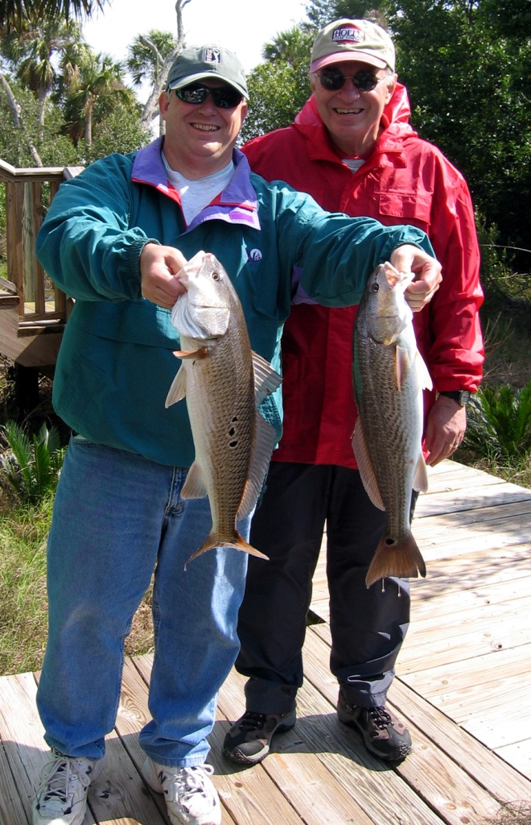
Visiting Professors
Kimberley J. Hansen, M.D.
Michael S. Conte, M.D.
Louis Messina, M.D.
Ronald Dalman, M.D.
David M. Williams, M.D.
Gregorio A. Sicard, M.D.
Frank W. Logerfo, M.D.
Robert M. Zwolak, M.D.
Ronald M. Fairman, M.D.
Michael Lawrence-Brown, M.D.
Spence Taylor, M.D.
Joseph Mills, M.D.
Timothy A. M. Chuter, MD
Harry (Hal) Dietz, MD
Gerald B. Zelenock, MD
Richard P. Cambria, MD
Carlos Donayre, MD

Slide 40
Standards of Excellence
Clinical Care
Research
Education

Slide 41
Clinical Research Interests
Aneurysm disease.
Endovascular aortic repair.
Hemodialysis access.
Lower extremity bypass.
Tertiary care vascular surgery.
“Write about what you do…”
-JMS

Slide 42
Research - Clinical
NIH Hemodialysis Fistula Maturation
NIH BEST Chronic Limb Ischemia
Vascular Quality Initiative
VA Cooperative studies
Industry-sponsored device trials
Industry-sponsored phamaceutical trials

Slide 43
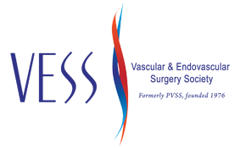
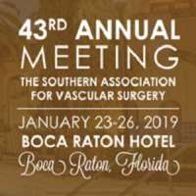
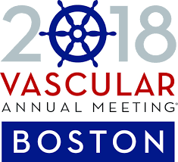
Fellow / Resident Research
Management of Patch Infections after CEA & Utility of Femoral Vein Interposition Bypass Javairiah Fatima, Vincent Fedeico, Salvatore Scali, Robert Feezor, Scott Berceli, Kristina Giles, Dean Arnaoutakis, Martin Back, Gilbert Upchurch, Thomas Huber
SAVS, Scottsdale, Arizona, January, 2018
Outcomes of Antegrade and Retrograde Open Mesenteric Bypass for Acute Mesenteric Ischemia Diego Ayo, Sal Scali, Kristina Giles, Sarah Gray, Paul Kubilis, Martin Back, Javairiah Fatima, Dean Arnaoutakis, Scott Berceli, Gib Upchurch, Robert Feezor, Thomas Huber
SAVS, Scottsdale, Arizone, January 2018
Contemporary Outcomes of Thoracofemoral Bypass Jeffery Crawford, Salvatore Scali, K. Giles, M. Back, Javaiariah Fatima, Dean Arnaoutakis, Scott Berceli, Gib Upchurch, Thomas Huber
SCVS, Las Vegas, March, 2018
Management of Complex Vascular Surgery Groin Wound Complications Salim Lala, Salvatore Scali, K. Giles, M. Back, Javaiariah Fatima, Dean Arnaoutakis, Scott Berceli, Gib Upchurch, Thomas Huber
PVSS/VAM, Boston, MA, June 2018
Comparative Outcomes of Open, Hybrid, and Fenestrated Branched Endovascular Repair of Extent II and III Thoracoabdominal Aortic Aneurysms Dean Arnaoutakis, Salvatore Scali, Adam Beck, Thomas Huber, Andrew Martin, Liza Laquian, Thomas Beaver, Gilbert Upchurch
SAVS, Boca Raton, FL, January 2019
Safety and Efficacy of Hybrid Thoracic Endovascular Aortic Repair for Management of Aberrant Subclavian Artery Complications Sarah Gray, Salvatore Scali, Kristina Giles, Dean Arnaoutakis, Martin Back, Michol Cooper, Scott Berceli, Gilbert Upchurch, Thomas Huber, Javairiah Fatima.
SCVS, Boca Raton, FL 2019
Treatment Strategies and Outcomes of Infected Thoracoabdominal and Pararenal Aortic Aneurysms Javairiah Fatima, Erik Anderson, Jeffrey Crawford, Michol Cooper, Salvatore Scali, Martin Back, Kristina Giles, Scott Berceli, Dean Arnaoutakis, Gilbert Upchurch, Thomas Huber
SCVS, Boca Raton, FL 2019
Management and Outcomes of Superior Mesenteric Artery Aneurysm Repair Zachary Hodges, Javairiah Fatima, Salvatore Scali, Robert Feezor, Martin Back, Kristina Giles, Scott Berceli, Michol Cooper, Dean Arnaoutakis, Thomas Huber, Gilbert Upchurch
SCVS, Boca Raton, FL 2019

Slide 46
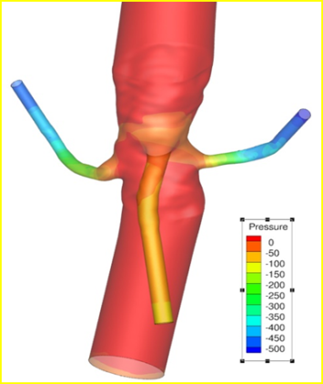
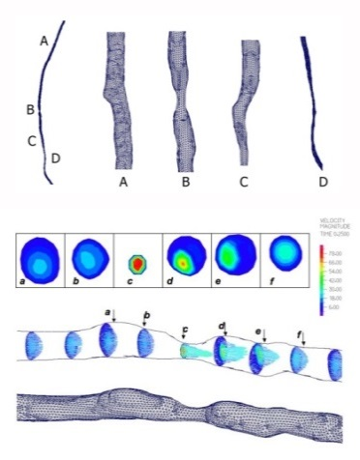
Research - Translational
Industry/University Cooperative Research Center - Computational Biology and Surgical Innovation
Genomic determinants of revascularization failure
Shear stress and the localization of vein graft lesions
Biologic mechanisms underlying ARHI
Biomechanics of advanced stent graft repair
Biomarkers of spinal cord ischemia
Support in recent years NIH, NSF, VA, Industry

Slide 47
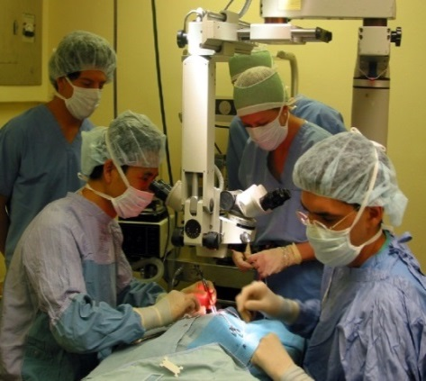
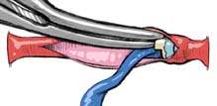
Research – Basic Science
Hemodynamics and vascular remodeling
Systems biology
Inflammation and immune response
Molecular basis for aneurysm development
Aortic Dissection Disease
Biology of Frailty
Biology of Access Related Hand Ischemia

Slide 48
Lifestyle and Amenities

Slide 49
Fellow Support
Computer/laptop.
Administrative support.
Educational support.
Travel - anticipated (SVS, SAVS, FVS).
Travel – presentations.
Rutherford’s Vascular Surgery.
Journal of Vascular Surgery.
Equipment (i.e. apron, glasses, coats, cards).
Discretionary funds.

Slide 50
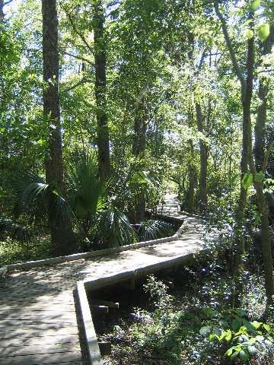
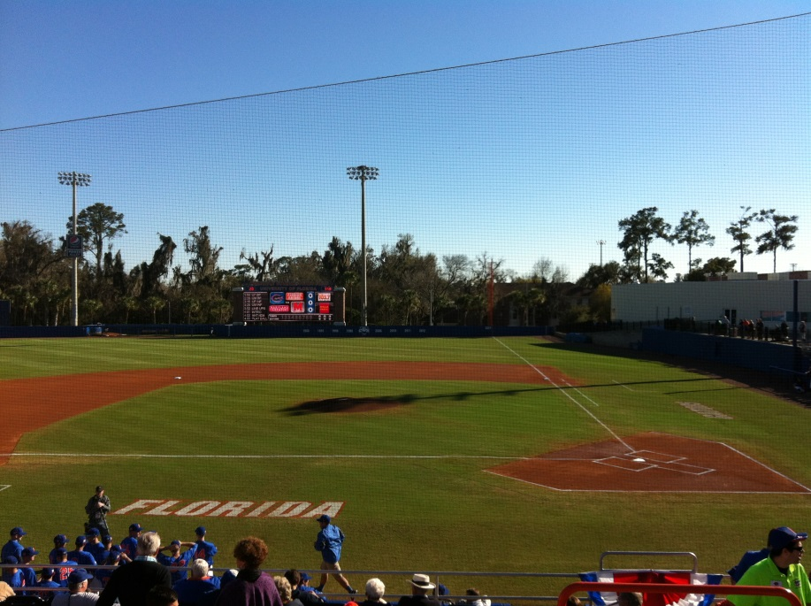
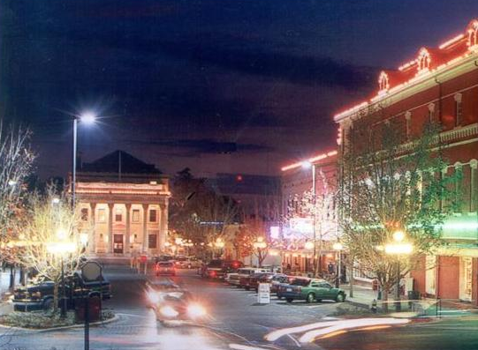
Gainesville, Florida
College town.
Great sports.
Great weather.
Affordable, quality housing.
Excellent for families.
Great week-end getaway spots.

Slide 51
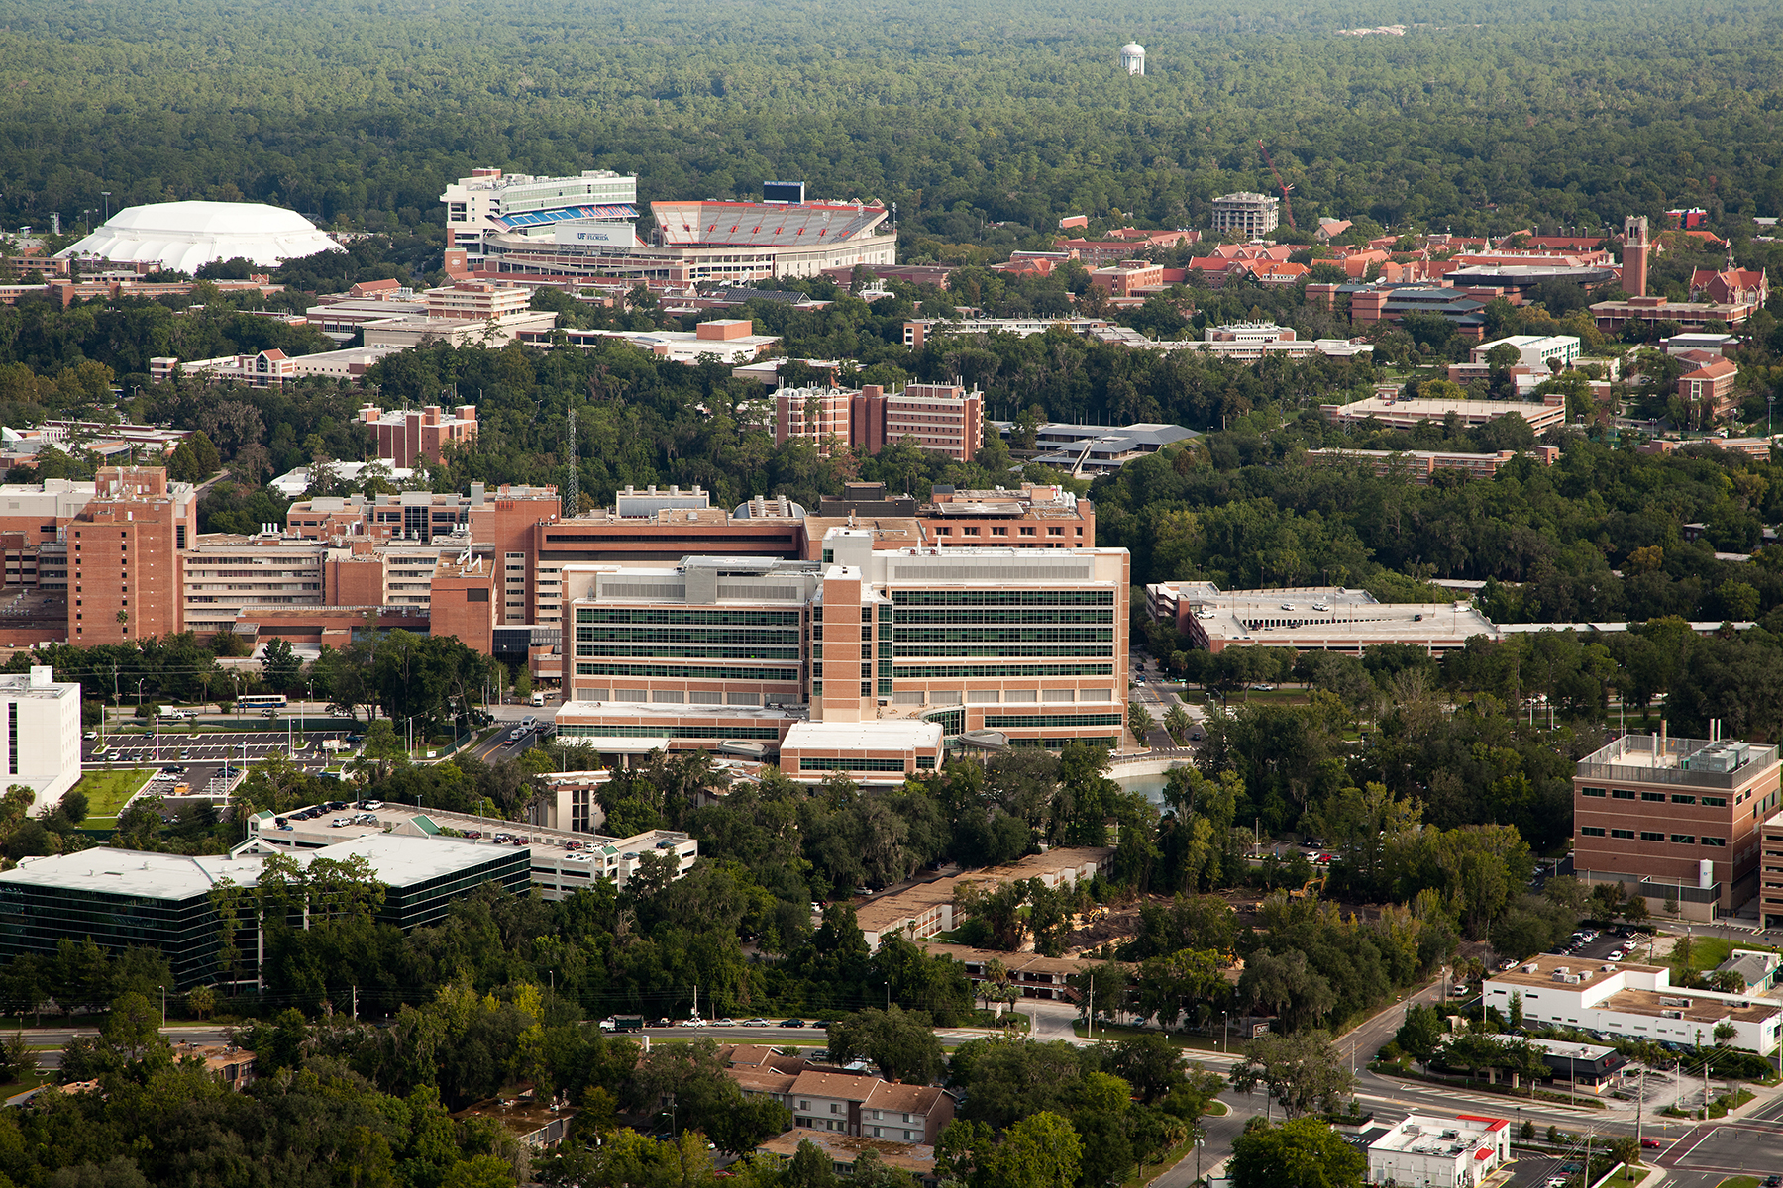

Slide 52
Future Directions
Sustained clinical growth.
Cardiovascular Center.
Heart and Vascular Hospital.
Aortic Treatment Center.
Limb Salvage initiative.
Continued academic emphasis.

Slide 53
Thank You, and Welcome!
Tradition of excellence.
Rich educational experience.
Supportive environment.

Slide 54
